Slide 1

2023
AIR QUALITY INDEX
PREDICTION
WITH MACHINE LEARNING MODEL

Slide 2
DETAILED VIEW OF PROJECT
Input Data and Parameters:
This section represents the input data and parameters required for the air quality prediction model.
It includes various data sources and parameters like air quality data source, weather forecast data source, historical AQI data source, machine learning algorithm, feature extraction, data preprocessing, model training, and performance evaluation metrics.
Air Quality Data Source:
This component represents the source of air quality data used for the prediction.
It could be a dataset containing information about pollutants like Sulphur Dioxide (SO2), Carbon Monoxide (CO2), Nitrogen Dioxide (NO2), and Particulate Matter (PM2.5, PM10).
The data source provides the necessary information for training and evaluating the prediction models.
Weather Forecast Data Source:
This component represents the source of weather forecast data used in conjunction with the air quality data.
It provides information about weather conditions like temperature, humidity, wind speed, etc., which can have an impact on air quality.
Integrating weather forecast data enhances the accuracy of the air quality prediction model.
Historical AQI Data Source:
This component represents the historical Air Quality Index (AQI) data source.
It contains past AQI values for different locations in India, which can be used for model training and evaluation purposes.
Historical data helps in understanding patterns, trends, and seasonality in air quality, enabling better prediction accuracy.
Machine Learning Algorithm:

Slide 3
This section represents the
This section represents the machine learning algorithm used for the air quality prediction model.
It could be regression techniques like Linear Regression (LR), Decision Tree Regressor (DTR), Random Forest (RF), or classification techniques like Logistic Regression (LR), Decision Tree (DT), Random Forest (RF), .
Different algorithms are employed to achieve the best prediction accuracy for AQI scores and classification.
Feature Extraction:
Feature extraction is the process of selecting and transforming relevant features from the input data.
It helps in identifying the most significant factors affecting air quality and capturing their impact on the prediction models.
Feature extraction techniques like Principal Component Analysis (PCA) or domain-specific knowledge can be used.
Data Preprocessing:
Data preprocessing involves cleaning, transforming, and normalizing the input data to ensure its suitability for model training.
It includes tasks like handling missing values, removing outliers, scaling features, and encoding categorical variables.
Proper data preprocessing enhances the performance and robustness of the prediction models.
Model Training:
This component represents the process of training the regression and classification models using the prepared data.
Model training involves splitting the dataset into training and validation sets, applying the chosen machine learning algorithms, and optimizing model parameters.
The trained models capture the relationships between the input features and the target variables (AQI scores and classification labels).
Performance Evaluation Metrics:
Performance evaluation metrics assess the accuracy and effectiveness of the prediction models.
Common metrics include Mean Squared Error (MSE), Root Mean Squared Error (RMSE), Mean Absolute Error (MAE), and Kappa Score.

Slide 4
Regression Model and Classification Model:
This section represents the regression model and classification model used for air quality prediction.
The regression model predicts the AQI score based on the input features, while the classification model classifies the air quality based on predefined categories.
Different algorithms and techniques are employed for regression and classification tasks.
Merging and Prediction:
This component involves merging the outputs of the regression and classification models to generate the final air quality prediction.
The models' predictions are combined based on certain rules or thresholds to provide a comprehensive assessment of air quality.
Performance Evaluation:
Performance evaluation assesses the accuracy of the prediction models and the overall system.
It includes evaluating the model's performance on unseen data, calculating error rates using the chosen evaluation metrics, and comparing the results with predefined thresholds or benchmarks.
Performance evaluation helps in identifying the strengths and weaknesses of the prediction models.
Error Analysis:
Error analysis investigates the discrepancies between the predicted and actual values.
It helps in identifying patterns, specific areas of improvement, and potential causes of prediction errors.
Error analysis guides the refinement and enhancement of the air quality prediction system.
AQI Prediction and Classification:
This section represents the final output of the air quality prediction system, which includes the predicted AQI score and the classification of air quality.
The prediction and classification results provide information about the current air quality status and its potential impacts on health.

Slide 5
This component visually displays the predicted AQI score and the classification of air quality.
It can use color-coded indicators, textual labels, or graphical representations to convey the air quality information effectively.
Audio Controls:
Audio controls enable the user to control the playback of audio associated with the air quality prediction system.
It includes buttons to play or pause the audio, providing an interactive and engaging user experience.
Deployment in Flask Server:
This section represents the deployment of the air quality prediction system using Flask, a Python web framework.
The system is deployed as a web application accessible through a Flask server.
Flask allows hosting the prediction system on a local or remote server, making it accessible to users through a web browser.
Tools Used:
The air quality prediction system is built using various tools like HTML, JavaScript, and CSS for frontend development.
Flask is used as the backend framework to handle HTTP requests, data processing, and model inference.
Machine learning libraries such as scikit-learn or TensorFlow are utilized for implementing the prediction models and evaluation metrics.

Slide 6
QUESTION STATEMENT
01
Air quality for a human being and all the living species is a vital part of life. Variation of
air quality creates a high impact on human life; continuous monitoring and evaluation and investigation of AIR quality are critical. Based on that, we are supposed to take and
action and control all the activities in every sense. To achieve this purpose

Slide 7
01
INTERSHIP PROJECT ARCHITECTURE
VISUALIZATION
AND
FEATURE ENGEENERING
EDA AND OUTLIER
REMOVAL
DEPLOYMENT
AND WITH USER
INTEFERENCE
MODEL BUILDING
AND EVALUATE
ACCURACY
Click here to add you to the center of the narrative thought
Click here to add you to the center of the narrative thought

Slide 8
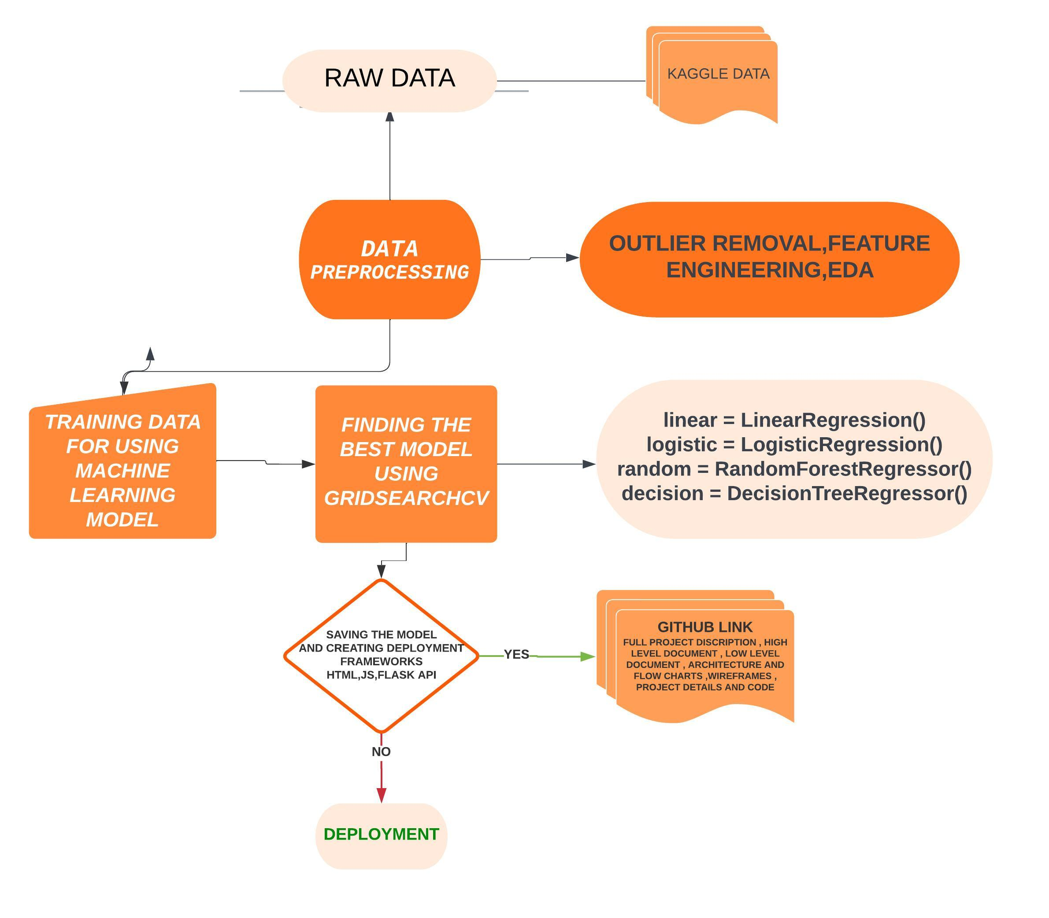

Slide 9
2
PROJECT SUMMARY
Prediction is based on the weather forecast. This study uses various time series forecasting techniques to predict
India's Air Quality Index (AQI) for the following periods. The pollutants level for Sulphur Dioxide (SO2),
Carbon Monoxide (CO2), Nitrogen Dioxide (NO2), and Particulate Matter (PM2.5, PM10), among others, have been
forecasted for different locations in India. Various evaluation metrics are applied to evaluate the model.
WE ARE CHAMPION
this paper also includes references from multiple sources that throw some light on air pollution's underlying issues.
As a result, this may be utilized for numerous future relevant research and discussions regarding India's air pollution.
For the implementation work, different machine learning methods were used. Some regression techniques like Linear Regression
LR), Decision Tree Regressor (DTR), Random Forrest (RF), and some classification techniques like Logistic Regression (LR),
Decision Tree (DT), Random Forrest (RF) have been applied to achieve a better result. Regression models were applied to
predict the AQI score, and classification models were built to classify the model based on the AQI score.
The performance measurements Mean Squared Error (MSE), Root Mean Squared Error (RMSE), Mean Absolute Error (MAE),
and Kappa Score are used to calculate error rates. Regression and Classification two models are merged for our prediction.
TEMPLATE
Ip = [IHi – ILo / BPHi – BPLo] (Cp – BPLo) + ILo
Ip = index of pollutant p Cp = truncated concentration of pollutant p
BPHi = concentration breakpoint i.e. greater than or equal to Cp BPLo = concentration breakpoint i.e. less than or equal to Cp
IHi = AQI value corresponding to BPHi ILo = AQI value corresponding to BPLo

Slide 10
How to calculate Air Quality Index?
The formula to calculate AQI is the same as per the Indian CPCB and US-EPA. The AQI is calculated using the equations separately for parameters. For example, if you wish to calculate AQI on the basis of four parameters, use the equation four times, and the worst sub-index communicates the AQI. A subindex is a linear function (two different yet related notions) of the concentration of pollutants.
1. Indian equation for AQI:
The Indian AQI range differs from that of US-EPA. To calculate AQI, a minimum of three parameters should be taken out of which one must be either PM10 or PM2.5.
To calculate sub-indices, 16 hours of data is needed.
For example: If you wish to calculate AQI on the basis of PM2.5, CO, and ozone, calculate the sub-index for each parameter separately.
If the current concentration of PM2.5 is 110 ug/m3, then referring to AQI range as per Indian standards BPHi = 120, BPLo = 91, IHi = 300 and ILo = 201.
Putting the values in equation and solving:
Sub Index= [(300-201)/ (120-91)] (110-91) + 201 = 265.86
Similarly, for other parameters, the sub-index can be calculated and the worst sub-index shows the AQI.

Slide 11
FORMULA
Ip = [IHi – ILo / BPHi – BPLo] (Cp – BPLo) + ILo
Ip = index of pollutant p
Cp = truncated concentration of pollutant p
BPHi = concentration breakpoint i.e. greater than or equal to Cp
BPLo = concentration breakpoint i.e. less than or equal to Cp
IHi = AQI value corresponding to BPHi
ILo = AQI value corresponding to BPLo

Slide 12
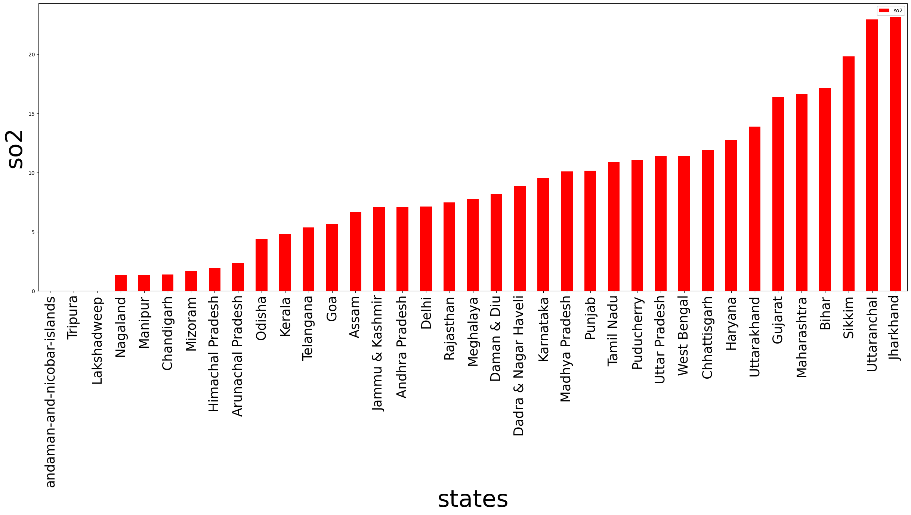

Slide 13
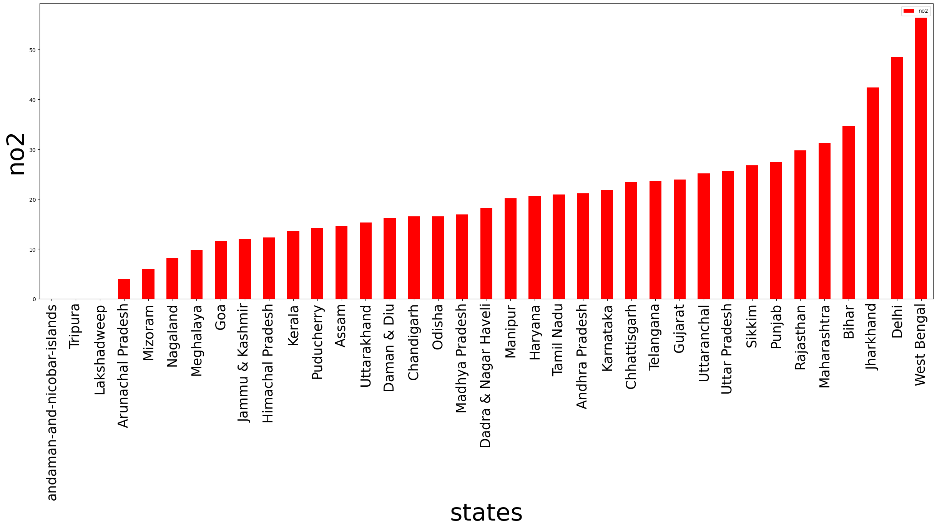

Slide 14
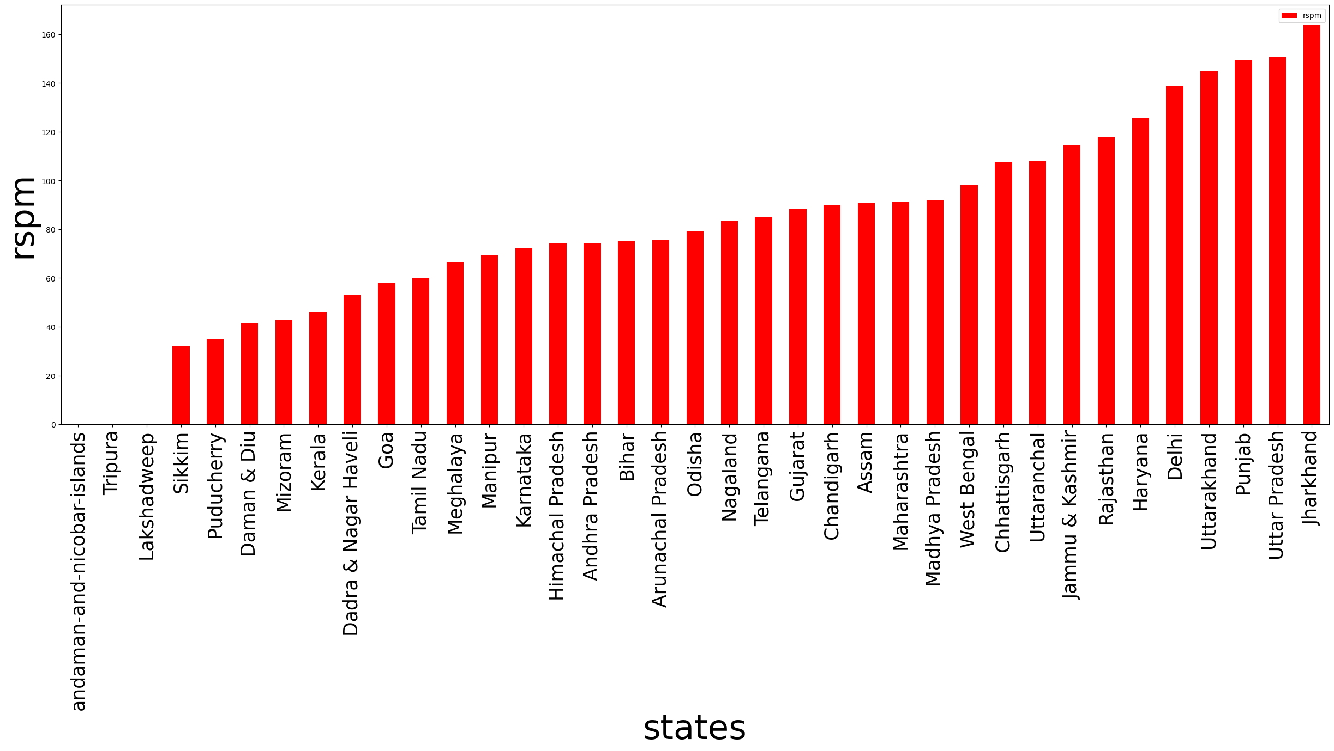

Slide 15
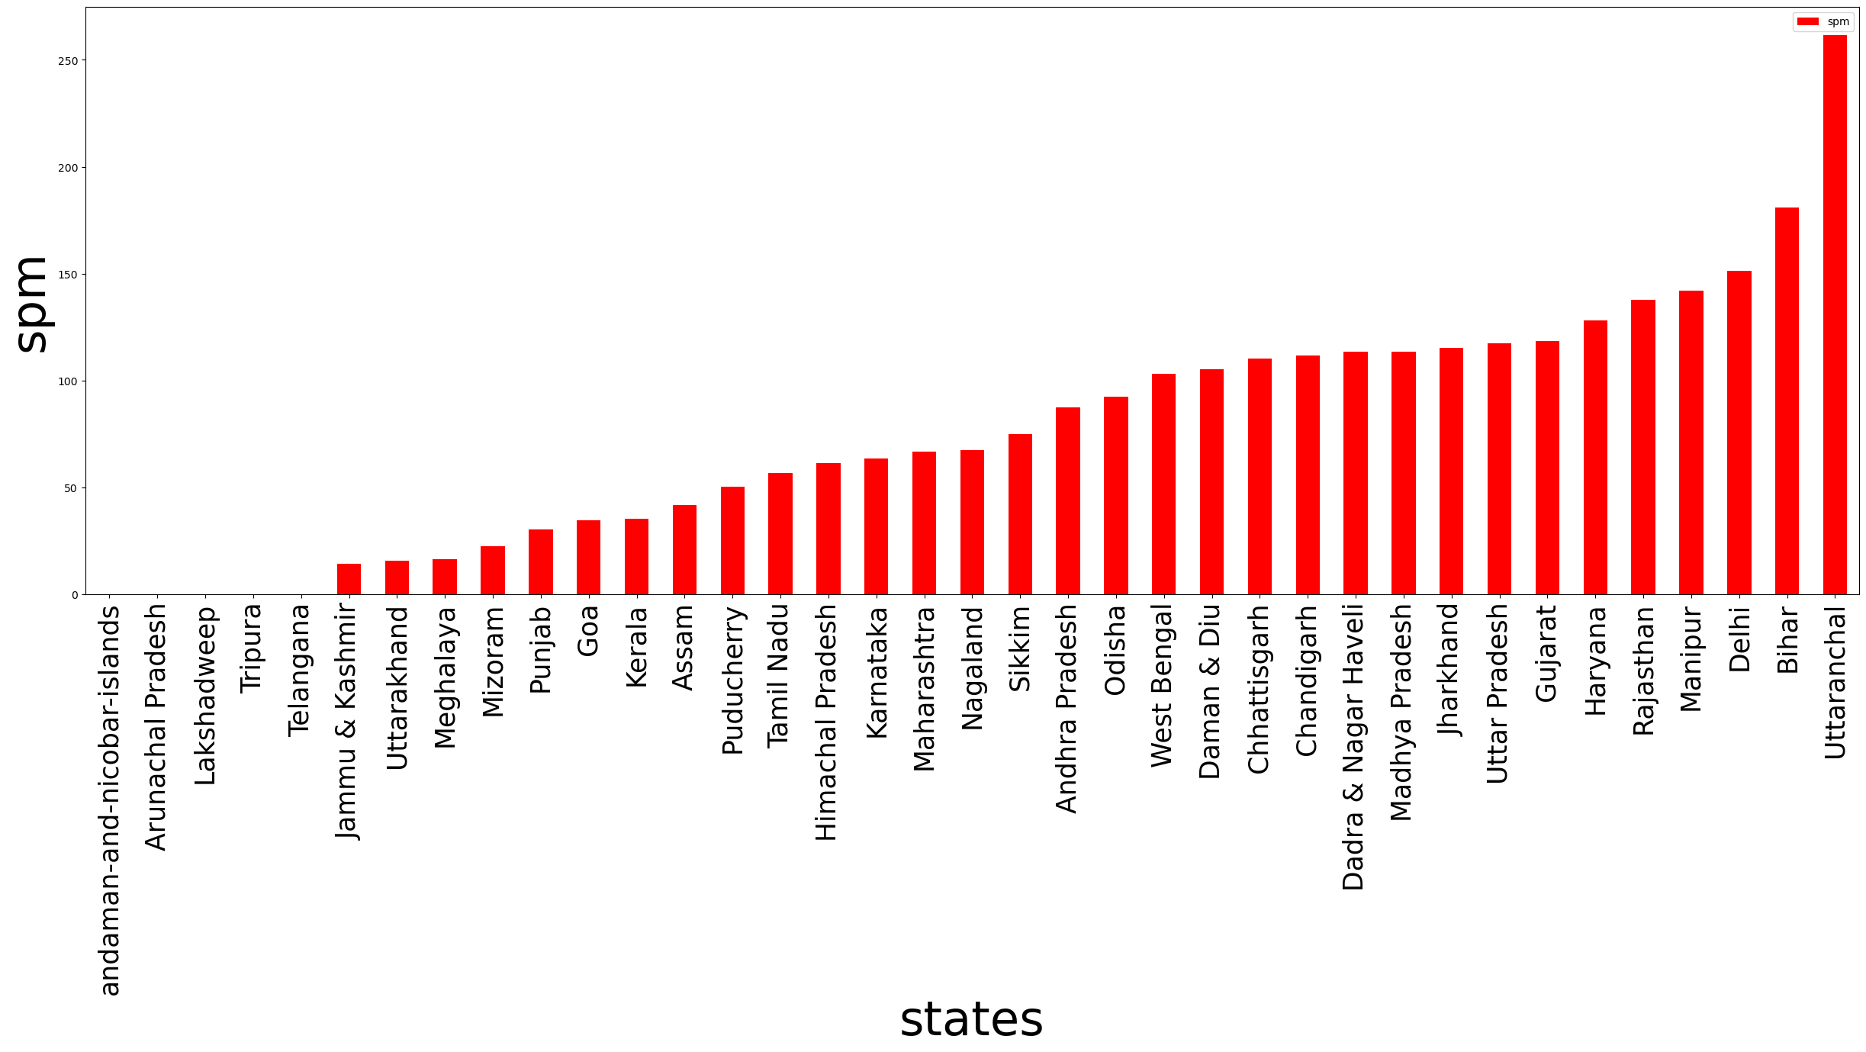

Slide 16
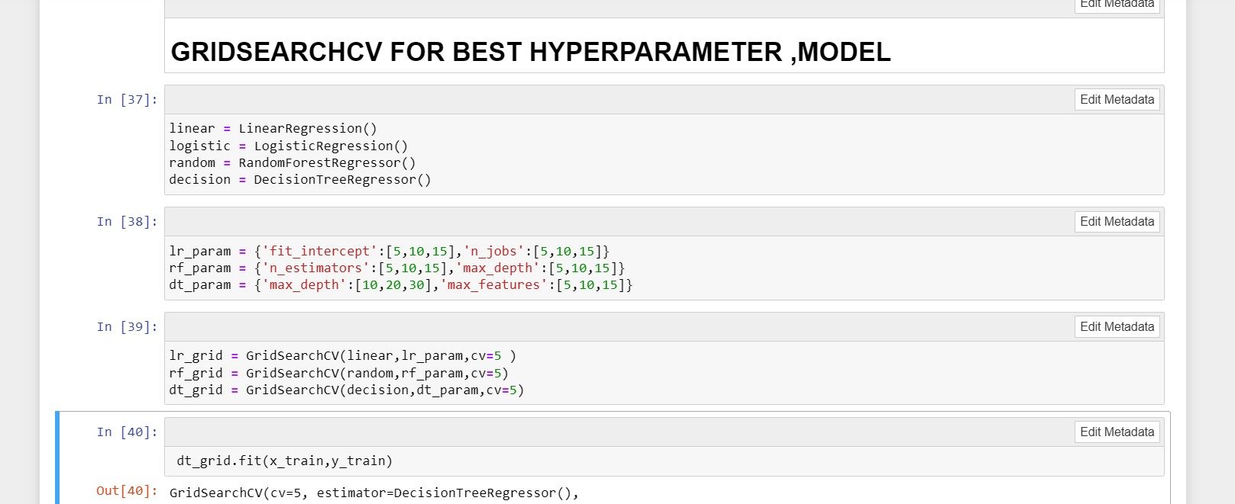
BUILDING MODELS

Slide 17
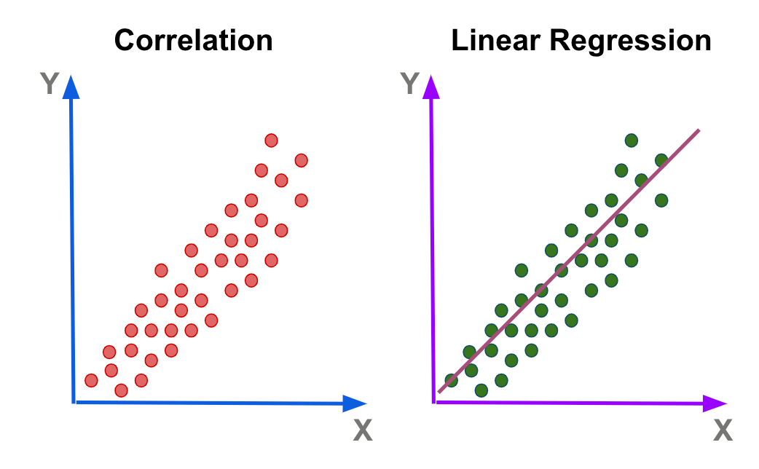

LINEAR REGRESSION
Simplicity and Interpretability: Linear regression models are simple and easy to understand. The relationship between the dependent variable and each independent variable is assumed to be linear, making it straightforward to interpret the coefficients of the model.
Predictive Power: Linear regression can provide reasonably accurate predictions, especially when there is a linear relationship between the independent variables and the dependent variable. It is effective when the underlying data follows a linear trend
DECISION TREE
Interpretability: Decision trees provide a clear and interpretable representation
of the decision-making process. The tree structure allows us to understand the
logic behind the predictions by following thebranches and nodes.

Slide 18


RANDOM FOREST
Robustness: Random Forest Classifier is known for its robustness against overfitting. It combines multiple decision trees, each trained on a different subset of the data with random feature selection. This ensemble approach reduces the risk of overfitting and helps to generalize well to unseen data, which is crucial for accurate AQI prediction.
Handling Nonlinear Relationships: Random Forest Classifier can effectively capture nonlinear relationships between input variables and the target variable. Air quality is influenced by various factors, such as pollutant levels, weather conditions, and geographical factors, which often exhibit complex interactions. Random Forest Classifier's ability to model nonlinear relationships makes it suitable for capturing the intricate patterns in air quality data.

Slide 19
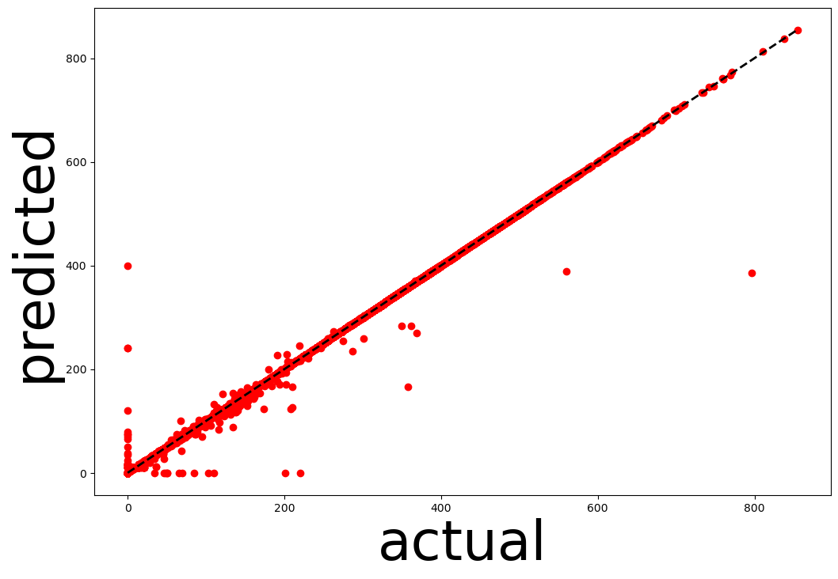

Slide 20
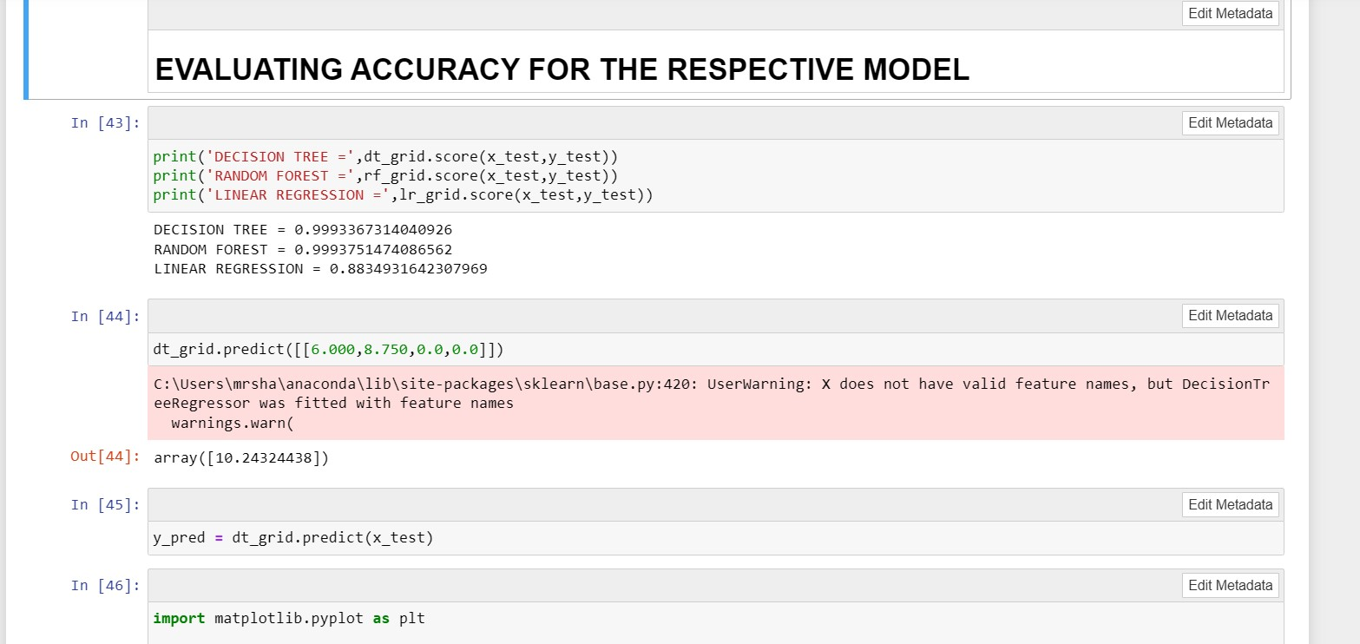
MODEL EVALUVATION AND DEPLOYMENT

Slide 21
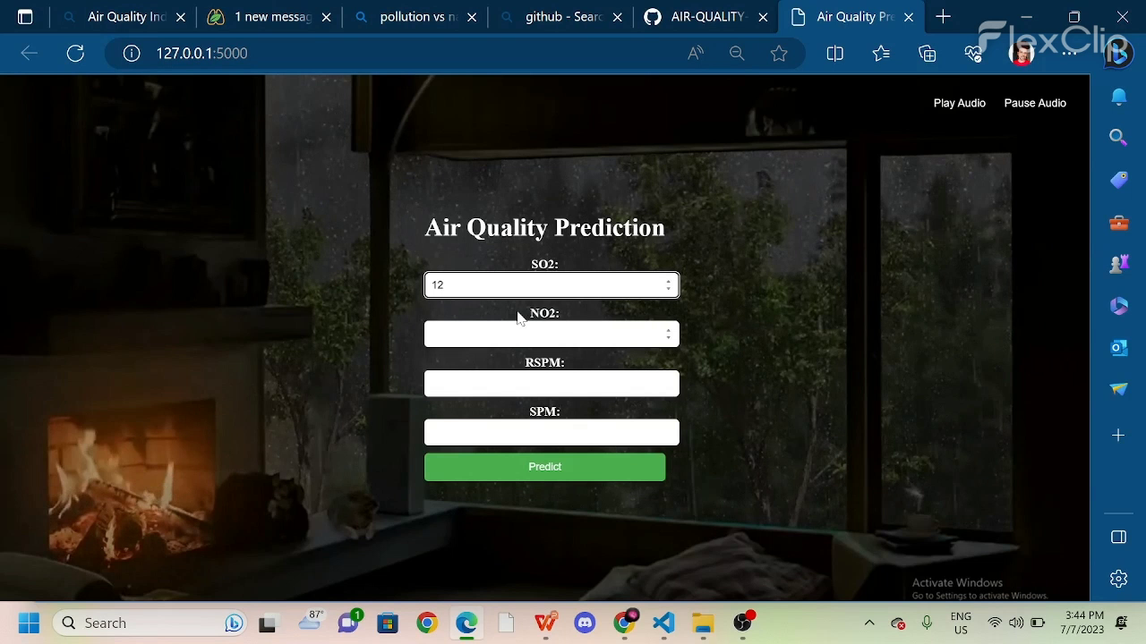
PLAY DEPLOYMENT VEDIO

Slide 22
10 Tips how you can reduce Air Pollution:
1. Limit the frequent use of vehicles
2. Quit smoking tobacco
3. Do not use and burn plastics
4. Minimize waste production
5. Buys things of use as it will reduce waste.
6. Minimize the use of air conditioners, refrigerants, and other coolants.
7. Follow the 5 R’s: Reuse, Reduce, Recycle, Repair, and Refuse.
8. Opt for public transport
9. Switch to renewable energy such as solar and wind energy
10. Get your kitchen chimneys clean regularly

Slide 23
ITS BEEN A PLEASURE .THANK YOU

